Slide 1

Session 7
TestNG Framework – Maven

Slide 2
Knowledge Check
Session 6
Implicit Wait vs Explicit Wait vs Fluent Wait
What are different methods to handle types of Alerts in WebDriver?
Types of Frame and how to work them in WebDriver?
Difference between getWindowHandle() and getWindowHandles()?
What are different ways to switch onto a Window?

Slide 3
Topics
Covered
Introduction to TestNG framework
Annotations
Introduction to Maven

Slide 4
Introduction to
TestNG framework
TestNG is a testing framework inspired from JUnit and NUnit but introducing some new functionality that make it more powerful and easier to use.
Some of the Benefits of TestNG:
  Annotations made testers life easy
  Test cases can be Grouped & Prioritized more easily
  It gives the ability to produce HTML Reports of execution
  Data Parameterization is possible

Slide 5
Introduction to
TestNG framework
How to add TestNG in java project:
  Using Jar file
  Eclipse Install software > Project Properties > Java Build Path > Libraries > Add Library
    Steps to install the TestNG in Eclipse: http://toolsqa.com/selenium-webdriver/install-testng/

Slide 6
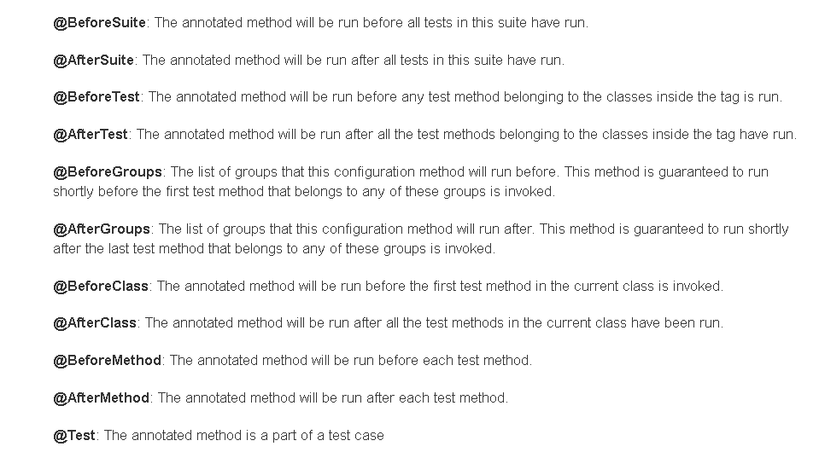
Annotations

Slide 7
Annotations
<BeforeSuite>
<BeforeTest>
<BeforeClass>
<BeforeMethod>
<Test>
<AfterMethod>
<AfterClass>
<AfterTest>
<AfterSuite>

Slide 8

Annotations
If you want the methods to be executed in a different order(by default, in alphabetic order), use the parameter "priority". Parameters are keywords that modify the annotation's function.
If you want the methods to be not executed, use the parameter “enabled“ which takes two value ‘true’ or ‘false’.

Slide 9
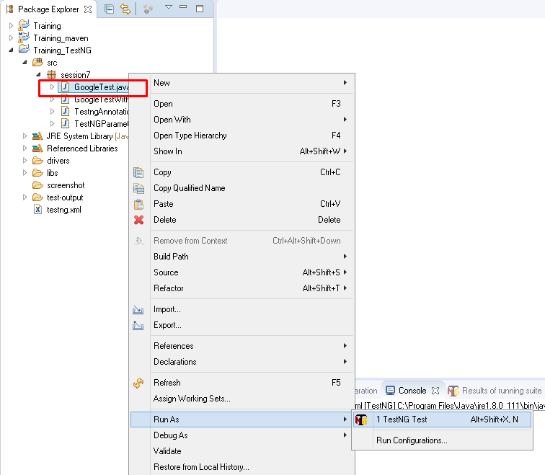
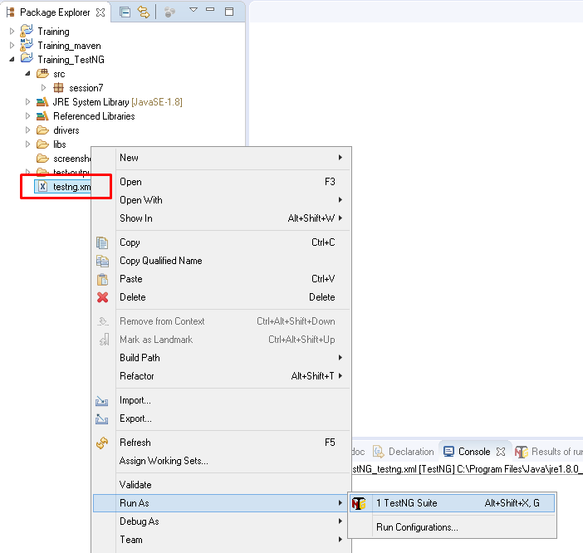
Annotations
How to run a TestNG suite in Eclipse:

Slide 10
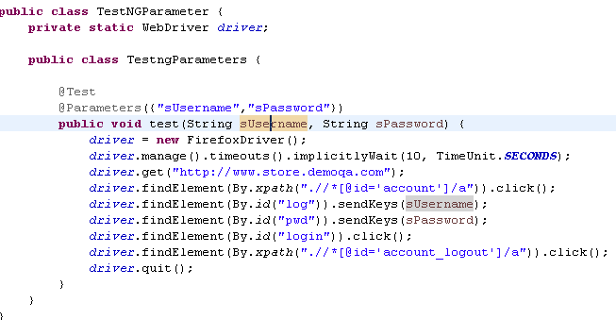
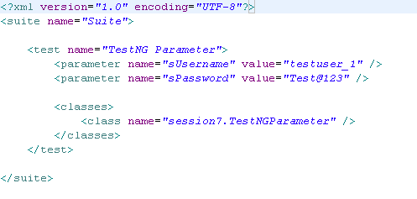
Annotations
TestNG Parameters and testing.xml file:

Slide 11
Annotations
When you need to pass complex parameters or parameters that need to be created from Java (complex objects, objects read from a property file or a database, etc…), in such cases parameters can be passed using Dataproviders.
Let’s see an example…..

Slide 12
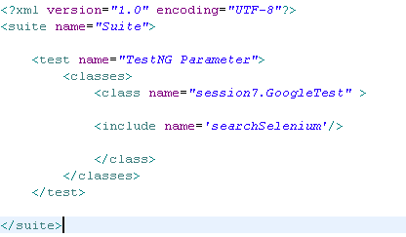
Annotations
What if you want to run only few tests and not the all available in suite? You can use testing.xml file to do that -

Slide 13
Introduction to
Maven
Maven is a powerful project management tool that is based on POM (project object model). It is used for projects build, dependency and documentation.
Without Maven:
  Adding set of Jars in each project.
  Creating the right project structure.
  Building and Deploying the project.
What is Build Tool?
Installation of Maven in Eclipse.(Demo):
http://toolsqa.com/java/maven/how-to-install-maven-eclipse-ide/

Slide 14
Introduction to
Maven
Maven Repository: A maven repository is a directory of packaged JAR file with pom.xml file.
Creating a Maven Project and adding jar.(Demo):
http://www.vogella.com/tutorials/EclipseMaven/article.html#exercise-create-a-new-maven-enabled-project-via-eclipse
Convert existing project into maven project.(Demo):
http://www.vogella.com/tutorials/EclipseMaven/article.html#exercise-add-maven-support-to-a-java-project-in-eclipse

Slide 15


Slide 16
Knowledge Check
What is TestNG? How it helps testers?
What are different ways to add TestNG into a java project?
What are important TestNG annotations?
What if dataProvider?
How you can execute tests in TestNG?
What is Maven? How it helps us?

Slide 17

Thank you!

